Slide 1


MSBA 305
DATABASE MANAGEMENT SOLUTIONS FOR
James Abbas
Ali Annan
Romanos Rizk
Sasha Nasser

Slide 2

About Linkers
Established in 1993
The company developed and expanded its activities to become through the years a highly recognized wholesale company in Lebanon in the household appliances and consumer electronics fields
Up until this day Linkers has not incorporated any kind of database management system into their business. They continue to input all inventory and order information into Excel

Slide 3

Problem Statement
Wholesale appliance companies like Linkers forecasting the inventory needed to meet market demands. Without direct access to customer data Linkers struggles to extract data into analytical data stores such as python. Linkers needs to design a database to track orders from their shops.
People can place an order of multiple products. They need to record what the order contains, who made the order, at what time and how much.
Finally, they want to track the name and price of products with the quantity of each product for each order.

Slide 4

Flexibility
Cost
Security
Proposed Database Applications for Linkers
MySQL
Compatitbility
Speed
Scalability
Reliability
Notes:
Scalability: MySQL can handle large amounts of data and scale with your business as it grows.
Reliability: Offers features like data replication and clustering for high availability and fault tolerance.
Speed: Designed for fast data retrieval, efficiently handling complex queries.
Flexibility: Supports a wide range of data types and can be easily integrated with other technologies.
Open-Source: Free to use with a large community of developers for support and development.
Security: Provides features such as encryption, authentication, and access control for data protection.
Compatibility: Works with various operating systems and programming languages, such as Python, for easy integration

Slide 5

Data Processing
Designing a Database
Proposed Solution
MySQL
Analytical Data Store

Slide 6






Data Pre-Processing
Converting ‘Date’ to Date Time Type
Illogical Values (like negatives)
Creating a Customer Dataframe
Creating an Order Dataframe
Creating a Product Dataframe
Creating a sub-Category Dataframe for each product family
Extracting Relevant Attributes from the 'Description' Column of each product sub-category dataframe
Transforming Column Names l
Normalizing ‘Description’ Column
Missing Values
Converting attributes to their corresponding Data Type
Normalising Categorical Columns

Slide 7


MySQL
A customer may place many orders
An order cannot belong to more than 1 customer
An order must contain 1 Item Code
An Item Code may be in many Orders
A product may be an LED

Slide 8




Family
Unit_Price
Features
Item Code
Description
Entity Relationship Diagram
Product Category
Contains
Product
Brand
Item Code
Product_class
Tot_qty
Description
Contains
Total_price
Item Code
Casa
CustomerID
OrderID
Date
Customer_
loyalty_indicator
Order
Makes
Customer
Return_rate
Quantity
Discount
CustomerID
Region
Phone_number

Slide 9
Database Schema
Microwave
Item Code
Size
Color
With_grill
Built_in
With_oven
Control_type
Product
Item_code
Brand
Unit_price
Description
Product_class
Family
Tot_qty
Order
OrderID
Return Rate
Discount
Customer_ID
Date
Quantity
Item Code
Customer
Customer_ID
Region
Casa
Phone_number
Customer_ loyalty_indicator

Slide 10






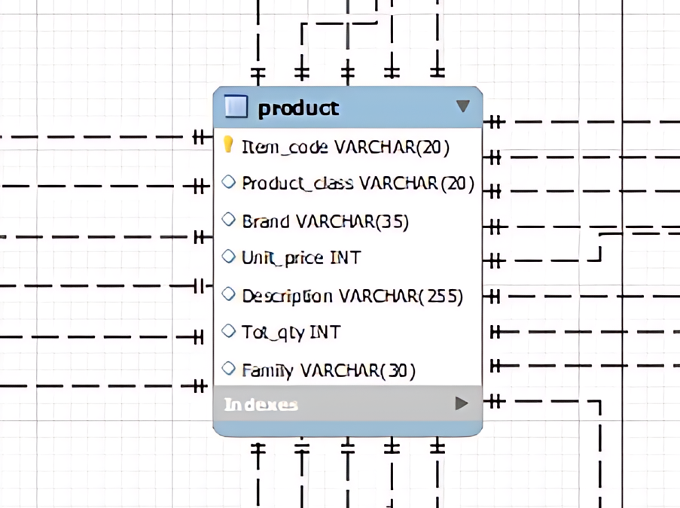


Defining Table Constraints
Customer
Each customer is identified uniquely by their customer ID.
Phone numbers are also unique for each customer.
Product
Each product has a unique code named item_code.
Orders
Each order has a unique order ID.
Orders are linked to customers.
Products in orders are linked to the product table.
Discounts must be between 0 and 100%.
Quantities in orders must be positive.
Foriegn key for Child tables
All foriegn keys in the child tables are subject to a cascade constraint

Slide 11

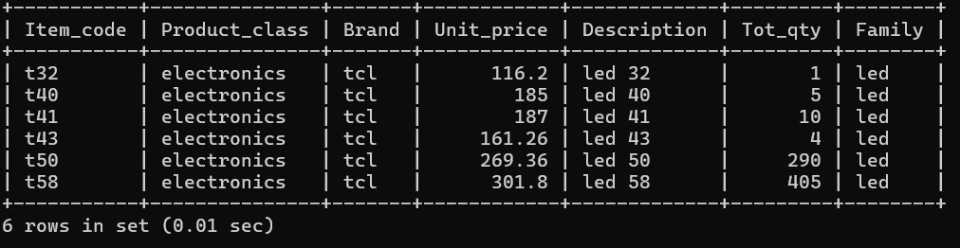
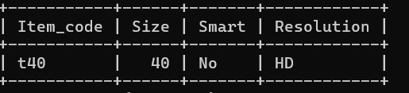
Business Scenarios
Client Calls
“Hello, I’m calling about your TCL TV products, which products do you currently have available”
SELECT * FROM product WHERE Family = 'led' AND Brand = 'tcl';
Client Accepts the pricing at 185$
SELECT * FROM led WHERE Item_code = 't40'

Slide 12

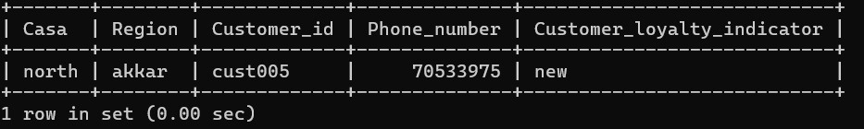
Business Scenarios
Client carries though with the order
“I like the specs, put me down for an order of 5”
“Sure, let me grab your phone number”
SELECT * FROM customer WHERE Phone_number = '70533975';
Client Accepts the pricing at 185$
SELECT * FROM led WHERE Item_code = 't40'
Client booked the order, Inserting into database
“OKAY ILL TAKE IT”
INSERT INTO order (Date, Customer_id, Item_code, Tot_qty, Discount, Total_price)
VALUES (CURDATE(), 'cust005', 't40', 5, 0.1, (5 * (SELECT Unit_price FROM product WHERE Item_code = 't40')));

Slide 13

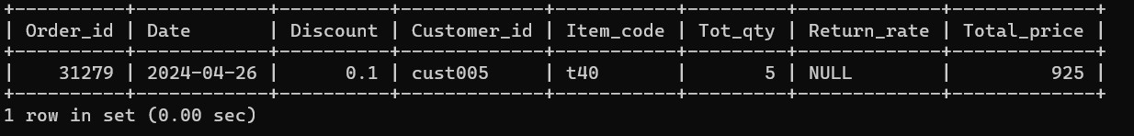
Business Scenarios
After creating the new order entry, the salesperson double checks that the order was properly placed for the right customer and following their requirements.
SELECT * FROM order AND Customer_id = cust005';

Slide 14
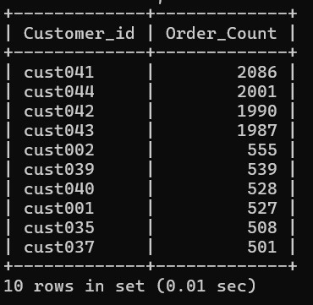
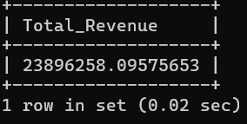
Business Scenarios
“The manager wants to identify the top 10 customers who have placed the most orders”
SELECT c.Customer_id, COUNT(o.Order_id) AS Order_Count
FROM customer c
LEFT JOIN order o ON c.Customer_id = o.Customer_id
GROUP BY c.Customer_id
ORDER BY Order_Count DESC
LIMIT 10;
“An employee needs to calculate the total revenue generated by the company within a specific time period”
SELECT SUM(Total_price) As Total_Revenue FROM order WHERE Date BETWEEN '2019-03-31' AND '2020-09-19';
Further Insights...
An employee wants to calculate the total revenue generated by each product family.
The database is not only useful for dealing with customers but also to extract quick insights about the company for managerial decisions
An employee wants to check the return rate for a specific product.

Slide 15
Analytical Data Store and Data Analysis - Predicting Sales
Once our data is extracted into Phython, Linkers can go about predict sales using Random Forest
Train, Test, Split
Feature Engineering
Model Building
Implement
missing values
categorical variables to numerical = one-hot encoding.
Extracted new features from the 'Date' column (year, month, day).
Dropped non-predictive columns
Good in predicting sales of
TV’s with an error
Training RMSE: 4.242415049431006
Validation RMSE: 13.094606117901842
Split into 80% Train and 20% Val
RandomForestRegressor = RMSE.

Slide 16
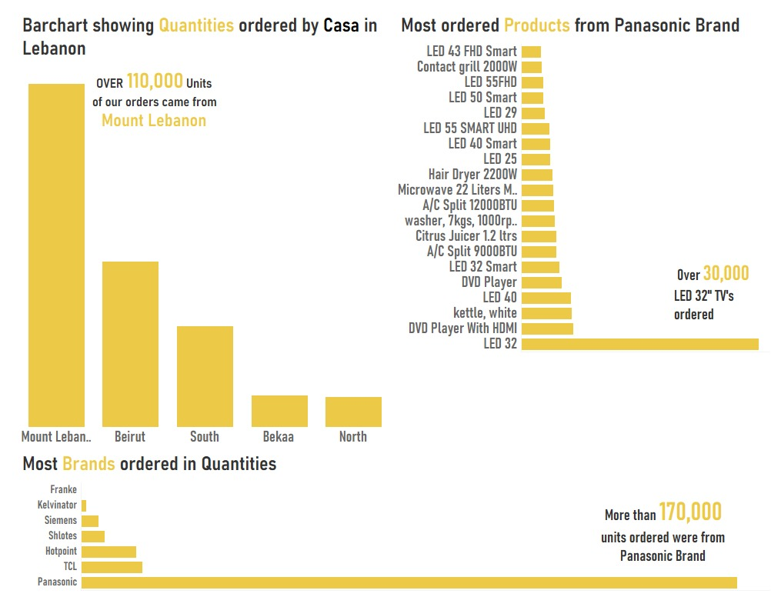
Visualization Dashboard

Slide 17




Recommendations and Limitations
What we did
Created a database for Linkers that reduced the data complexity (eliminate redundancies) present in the company and helped employees extract meaningful insights from data fast
Recommendation - User Authentication
Introduce a user authentication system to control access to the database. This ensures that only authorised users can view or modify data.
Recommendation- User Interface
Develop a user interface for the employee to retrieve customer and product data without the need to write the full SQL quires
Limitation - 1 Item Limit per Order
If a customer comes and orders multiple items on one day, the employee is required to record multiple records for each item ordered. This can be a limitation, however this is currently how Linkers operates.
Limitation - Employee Training
Linkers has been operating since 1993, this is the first time their employees will have encountered a database system. Employee training and implement parallel system (Excel and DBMS) until employees are fully ready for the switch.
Limitation - Primary Key
Since the primary key item code and customer ID is not a number but rather strings, there is no auto incrementation in MySQL. Thus each employee will have to manually create these ID for new customers.

Slide 18

THANK YOU

